Slide 1
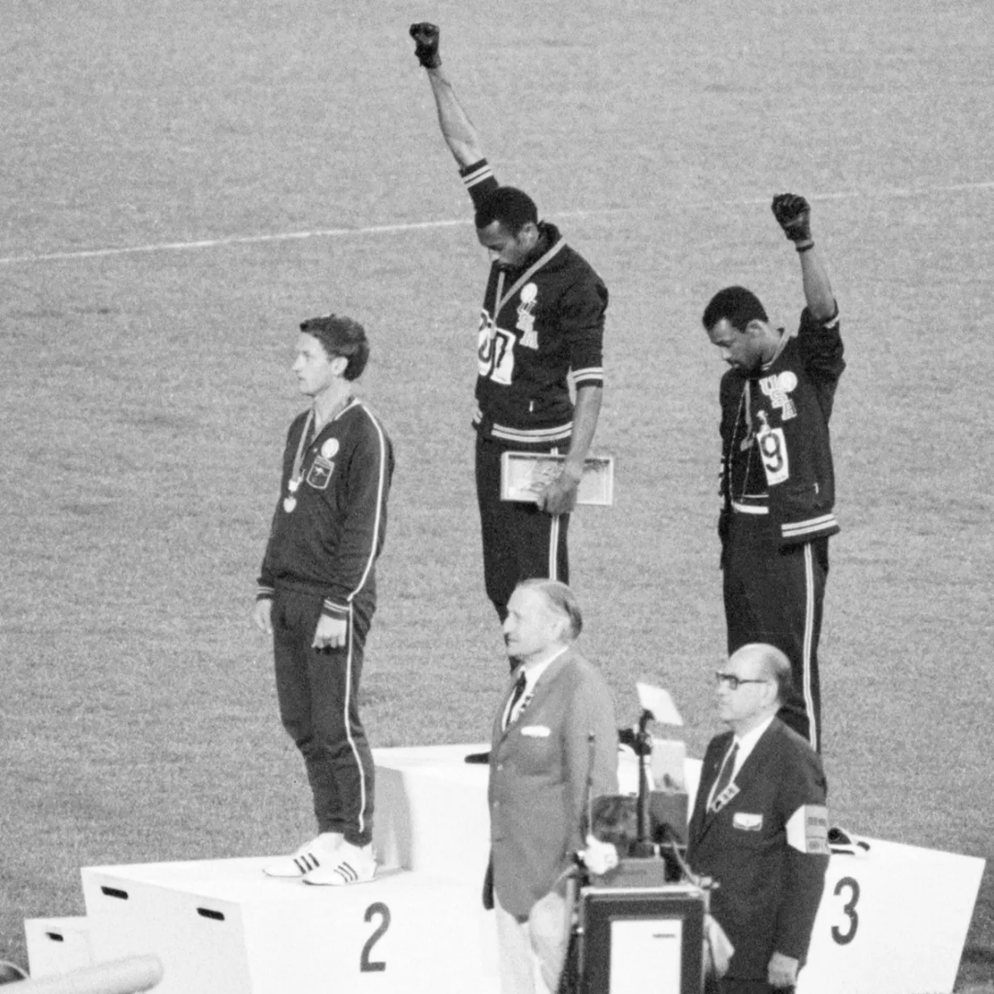
Growth and the Environment
The Environmental Kuznets Curve
International trade
Over time
Policy implications
Within countries
Environmental justice

Slide 2
0 Introduction
1 Social choice
2 Externalities and public goods
3 Decision analysis
4 Valuation: Aims and purpose
5 Valuation: Revealed preferences
6 Valuation: Stated preferences
7 Direct regulation
8 Market-based instruments
9 Growth and justice
10 Green accounting
11 Exam preparation

Slide 3
Growth and the Environment
The Environmental Kuznets Curve
International trade
Over time
Policy implications
Within countries
Environmental justice

Slide 4
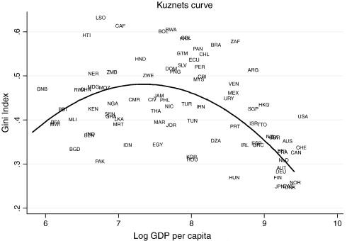
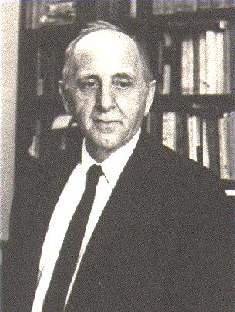
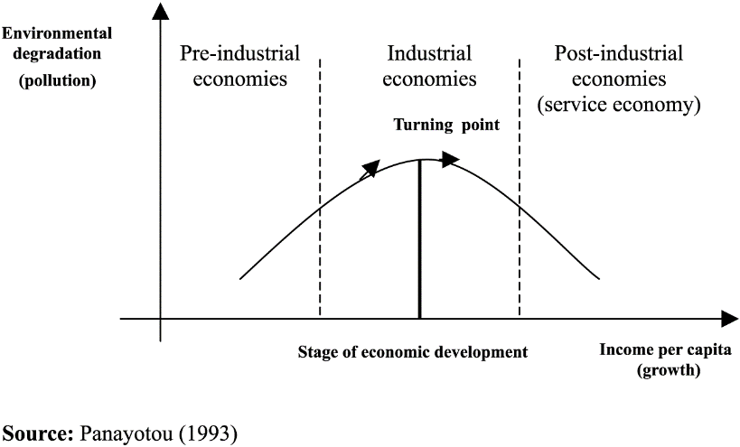

Slide 5




Slide 6
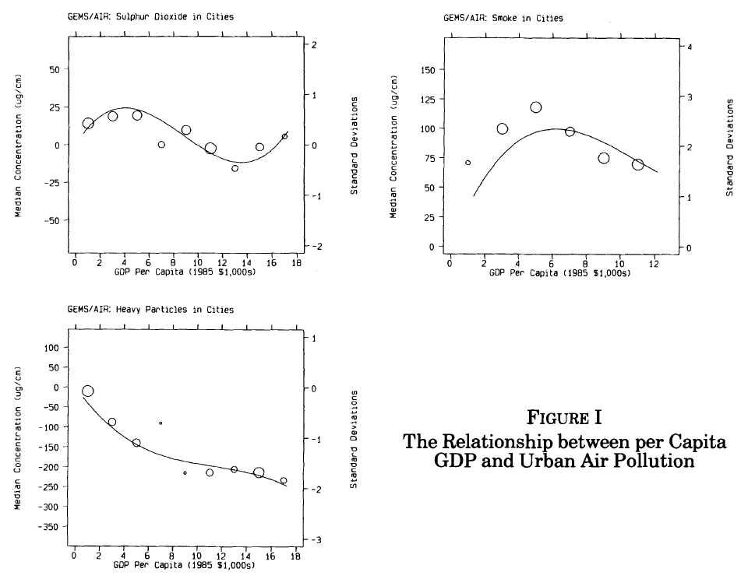

Slide 7
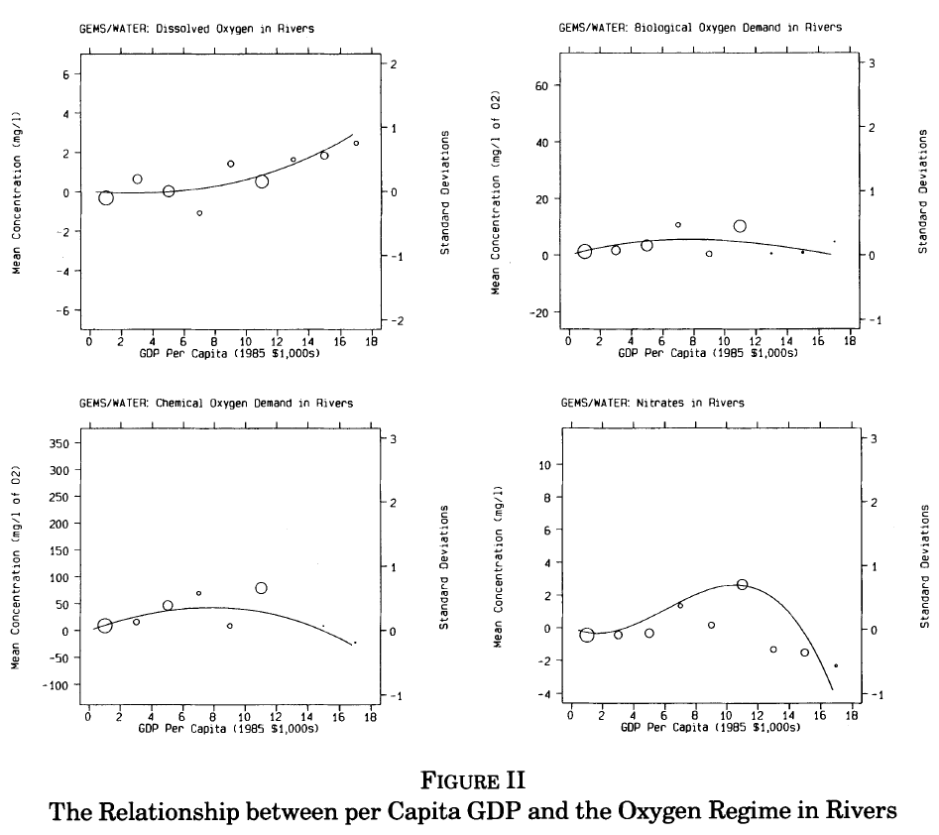

Slide 8
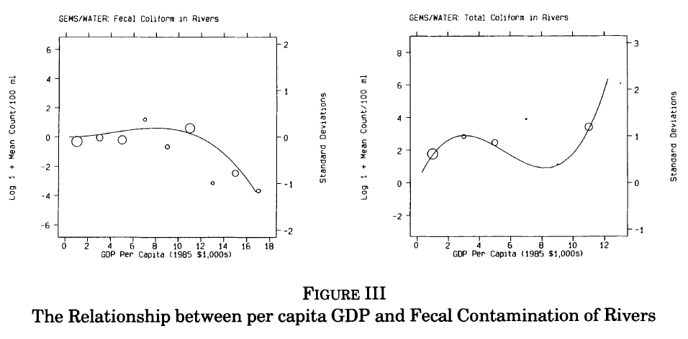

Slide 9
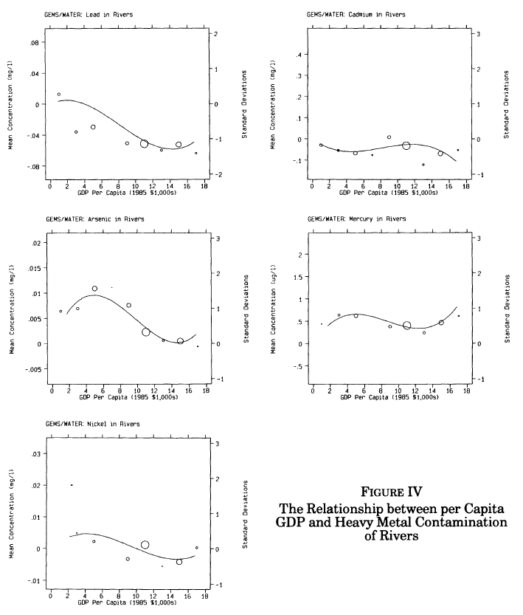

Slide 10
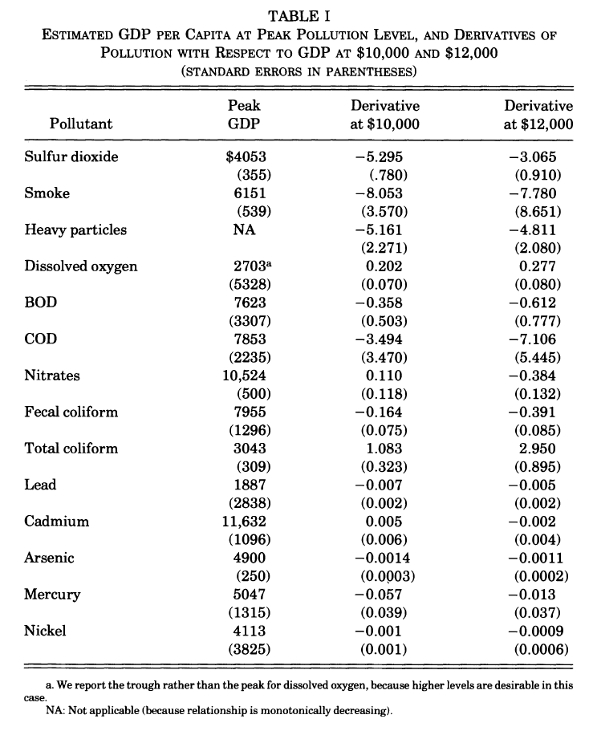

Slide 11

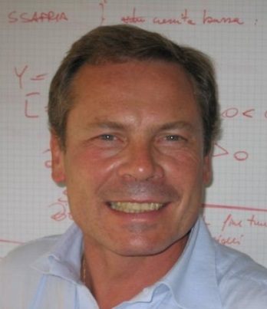

Environmental Kuznets Curve
The Grossman-Krueger (1991, 1995) papers spawned a large literature
Indicators of environmental quality
Countries, sectors
Time periods
Specifications
Estimators
Stern “the rise and fall of the EKC”
Galeotti “desperately seeking the EKC”

Slide 12
Growth and the Environment
Ambiguous results unsurprising
Economic growth has a number of effects
Scale – more, more, more
Composition – agriculture, manufacturing, services
Technology – improved efficiency, new things
Demand – for a cleaner environment
Governance – improved delivery, but longer deliberation

Slide 13
Environmental Kuznets Curve -2
Local pollutants harmful to human health indeed tend to rise then fall with economic development, but the turning point is different for different contaminants, countries, periods
For global issues, no Environmental Kuznets Curve in sight – or at least not for totals

Slide 14
Growth and the Environment
Productivity
The Environmental Kuznets Curve
International trade
Over time
Policy implications
Within countries
Environmental justice

Slide 15
Growth and the Environment
Ambiguous results unsurprising
Economic growth has a number of effects
Scale – more, more, more
Composition – agriculture, manufacturing, services
Technology – improved efficiency, new things
Demand – for a cleaner environment
Governance – improved delivery, but longer deliberation
This assumes a closed economy
International trade complicates things further

Slide 16
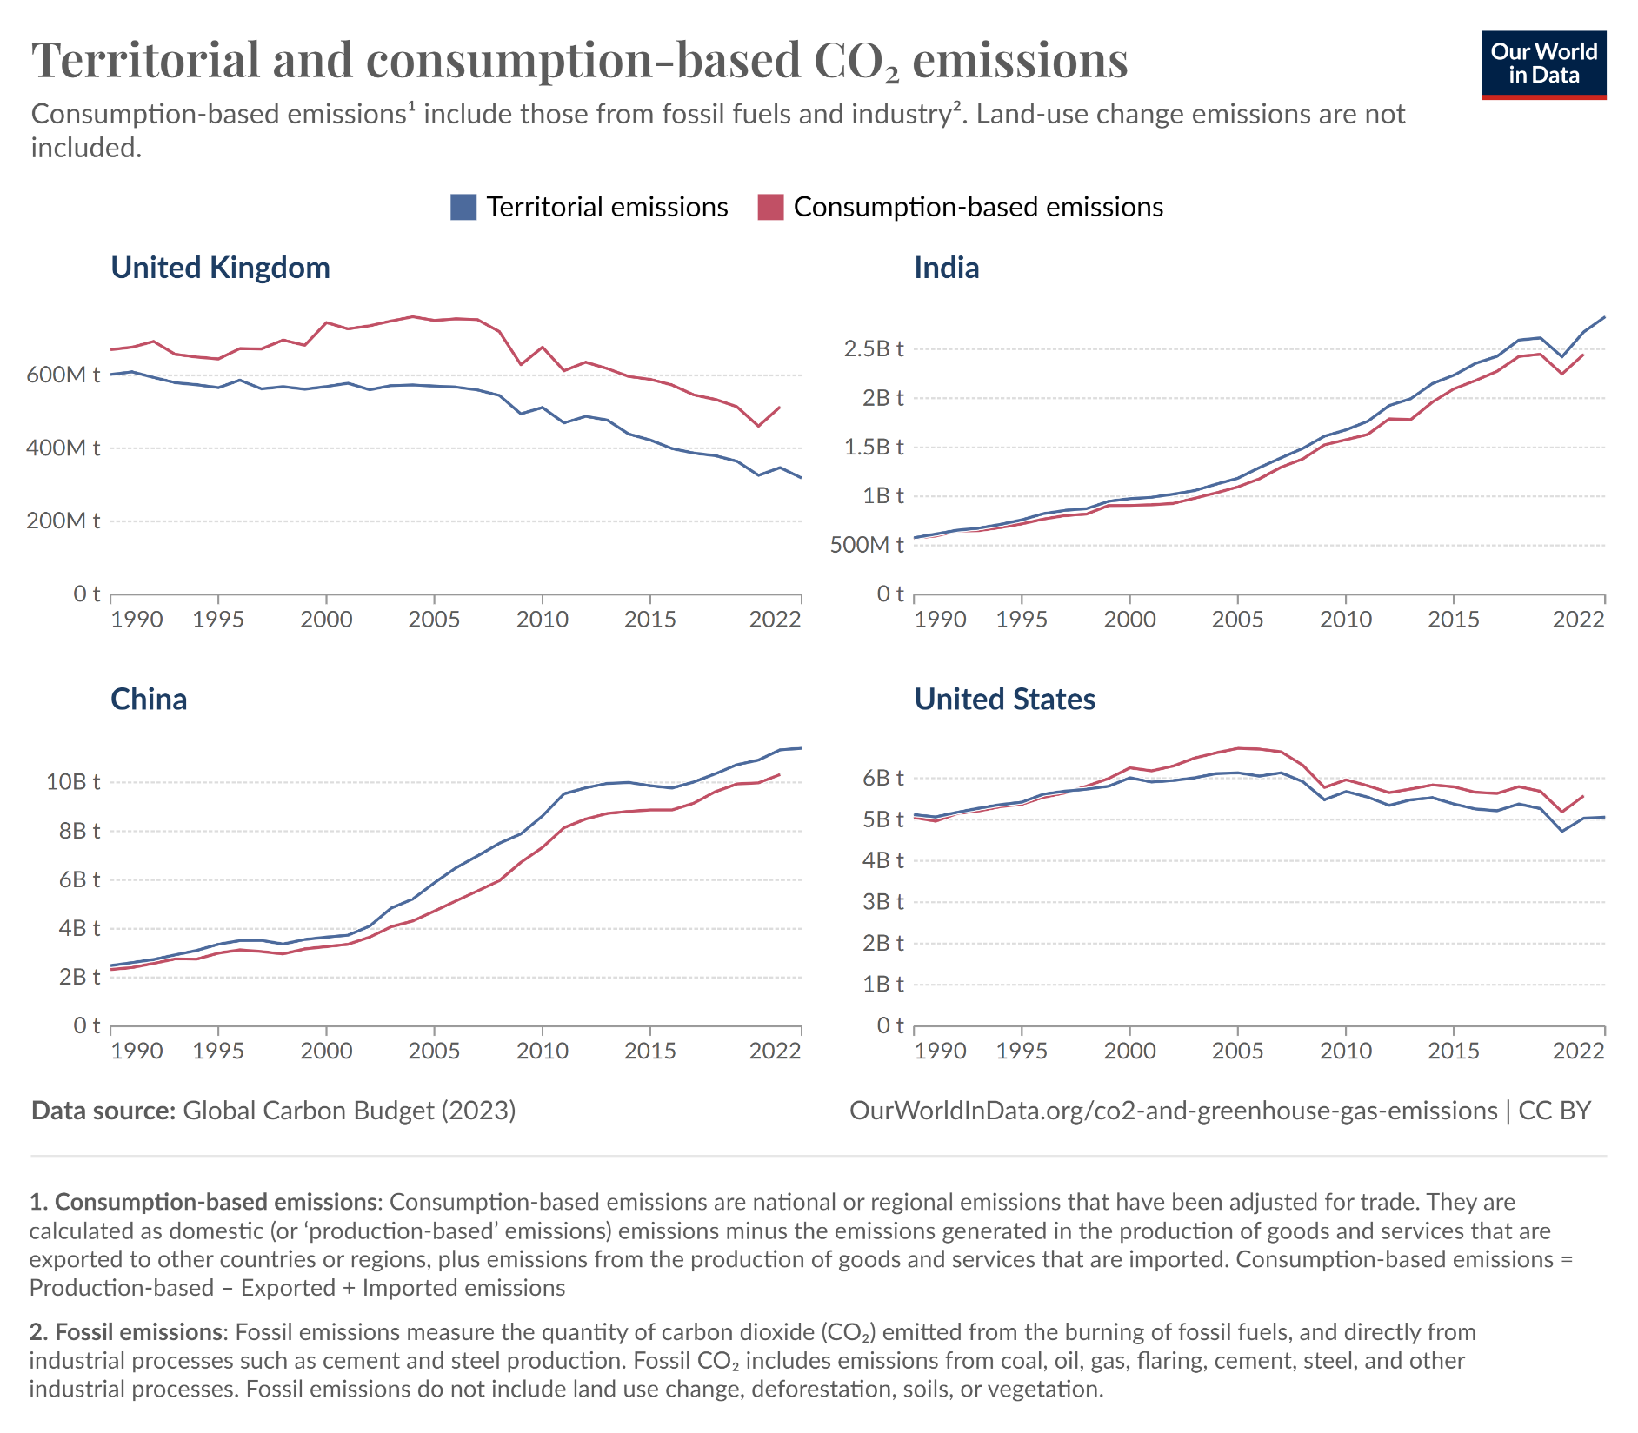

Slide 17
Trade affects
production &
consumption
and so
emissions &
environmental
Kuznets curve.

Slide 18
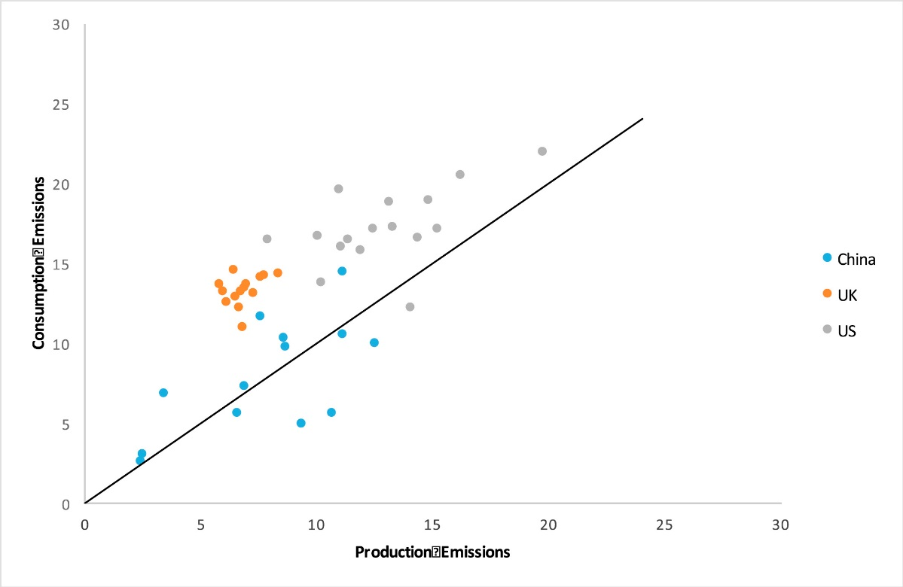
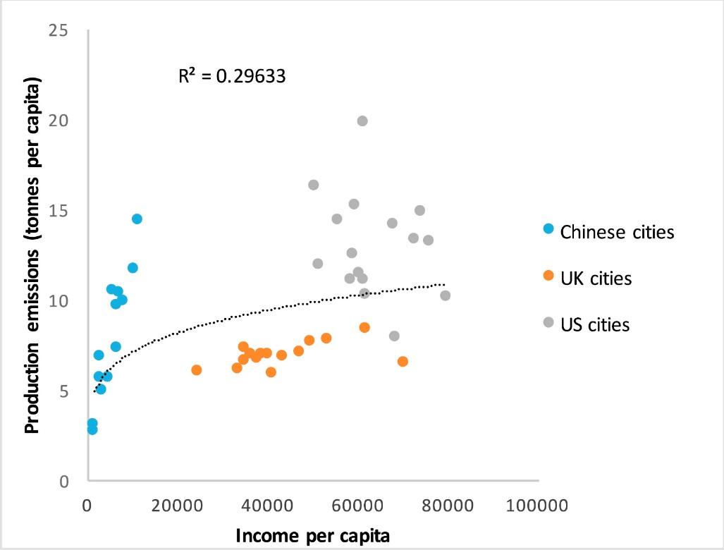
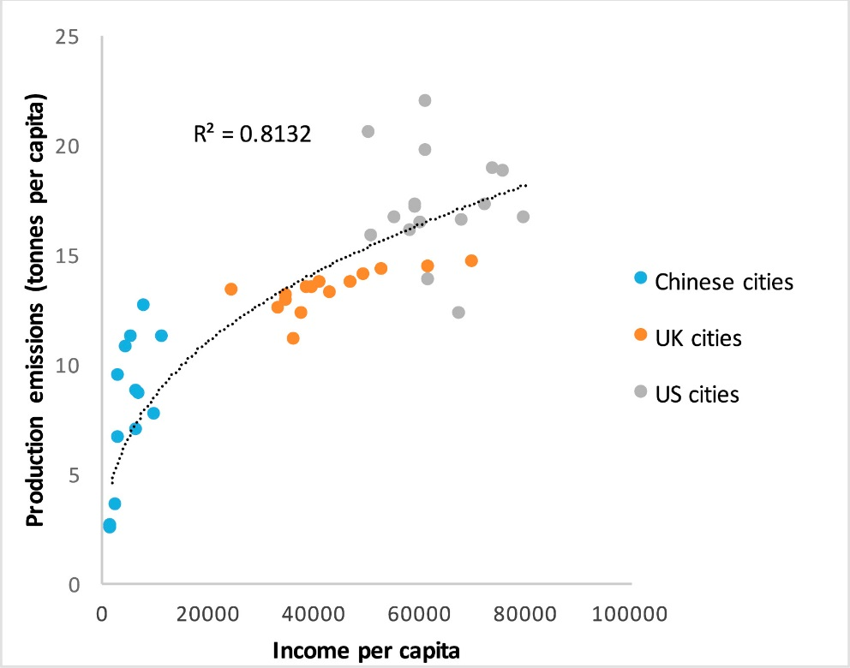
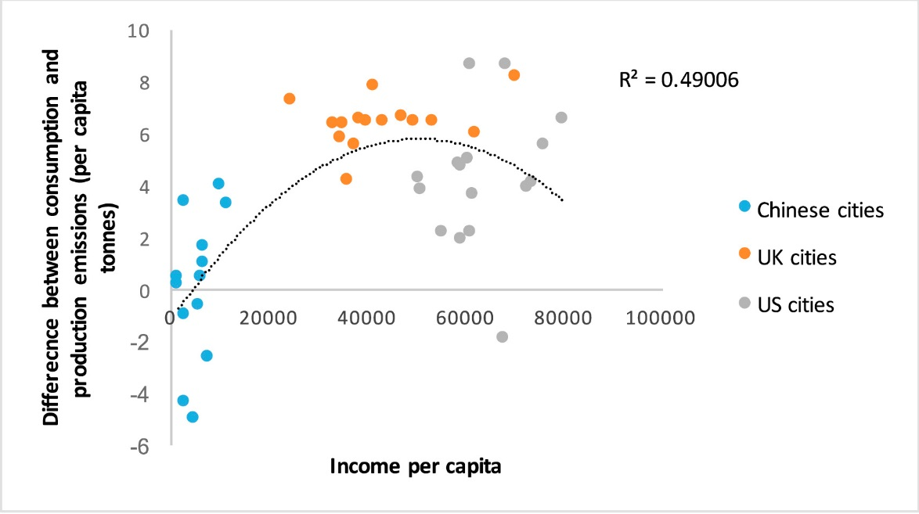
Consumption

Slide 19
International Trade
International trade further complicates the analysis of the Environmental Kuznets Curve
It is easy, indeed tempting, to mistake offshoring of production and hence pollution for a clean-up
Trends in exporting, assembling, and transit countries need similar care in their interpretation

Slide 20
Growth and the Environment
Productivity
The Environmental Kuznets Curve
International trade
Over time
Policy implications
Within countries
Environmental justice

Slide 21
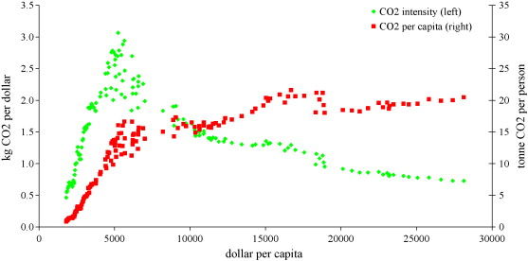
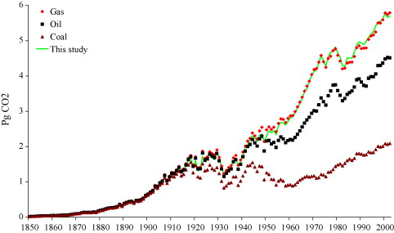

Slide 22
Policy Implications
The Environmental Kuznets Curve suggests a policy implication: Grow rich and all will be fine
However, the EKC is an association, no suggestion of a causal relationship
Let’s look at cycling

Slide 23
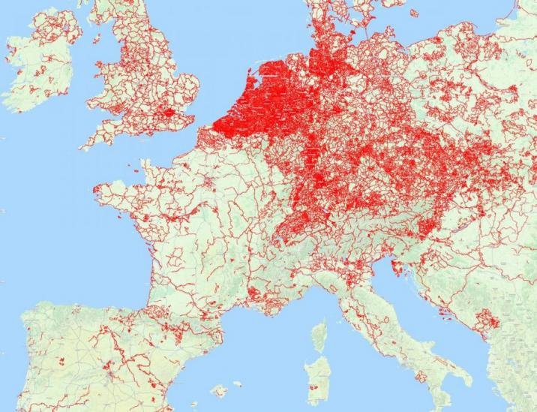
Cycle paths

Slide 24
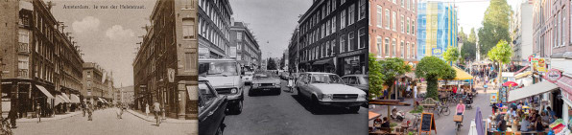
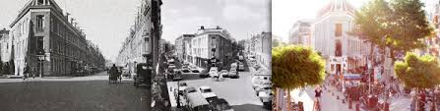
1950s 1970s 2020s
Two streets in Amsterdam

Slide 25
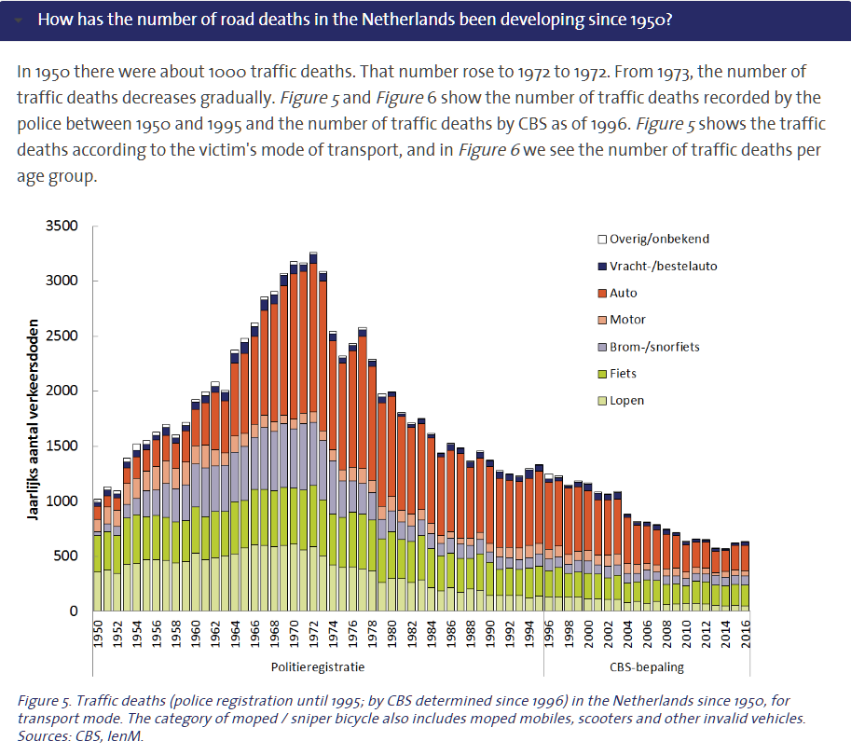

Slide 26
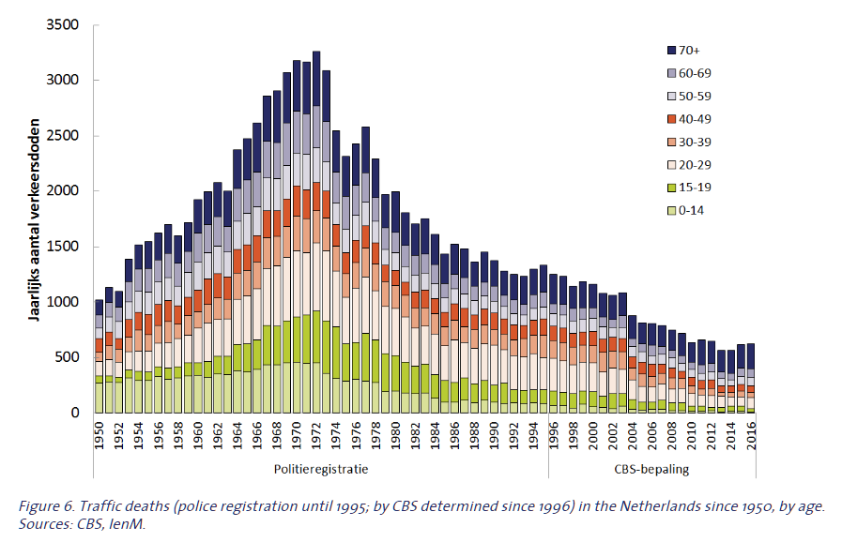

Slide 27


Slide 28
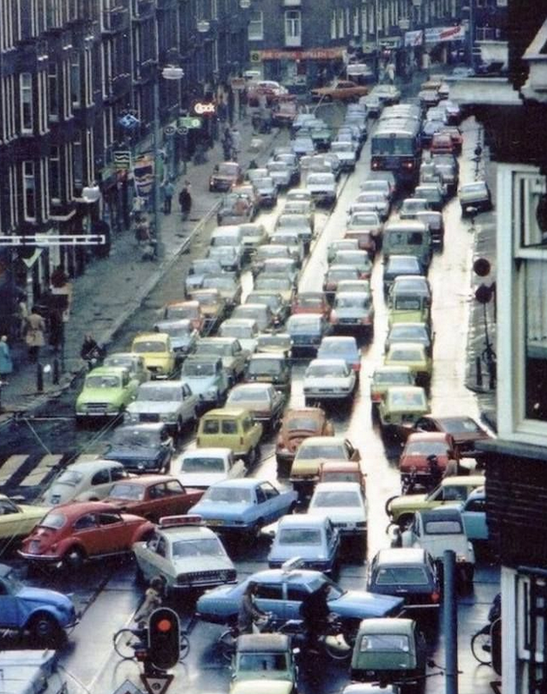
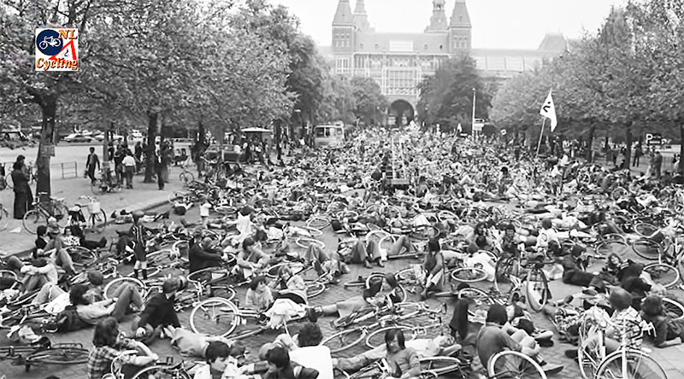
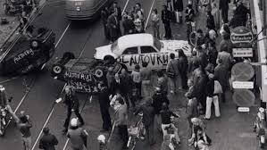
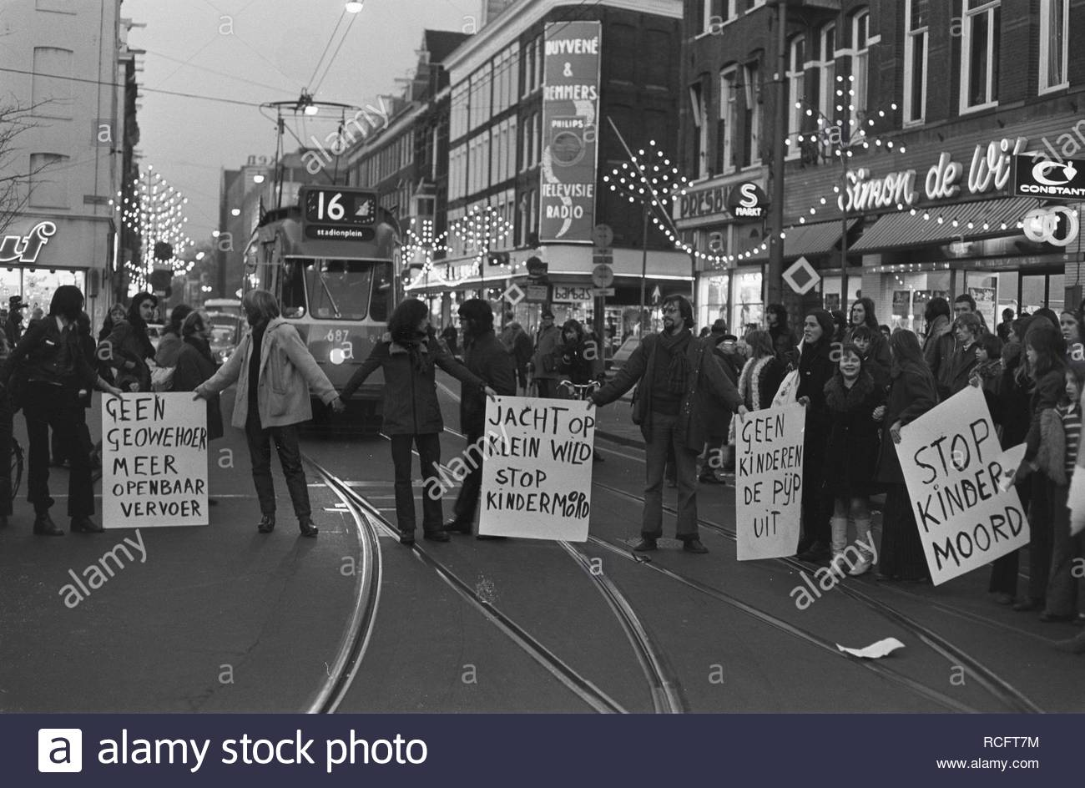

Slide 29
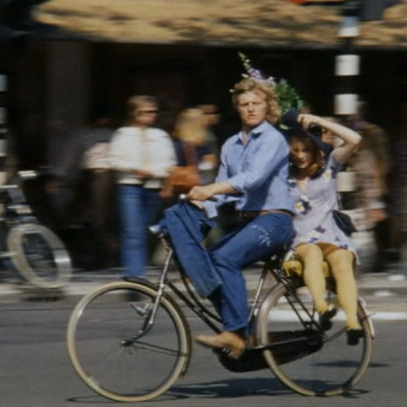
Rutger Hauer (e.g.,
Blade Runner) and
Monique van de Ven
(e.g., The Assault)
make cycling cool in 1973 movie Turkish Delight.

Slide 30
Policy Implications
The Environmental Kuznets Curve suggests a policy implication: Grow rich and all will be fine
However, the EKC is an association, no suggestion of a causal relationship
Environmental clean-up requires policy intervention

Slide 31
Growth and the Environment
Productivity
The Environmental Kuznets Curve
International trade
Over time
Policy implications
Within countries
Environmental justice
Incidence of environmental problems and policy

Slide 32
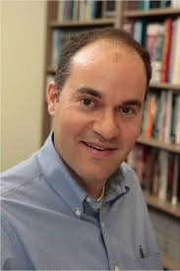
Poorer people drive older cars,
richer people drive more with heavier cars.

Slide 33
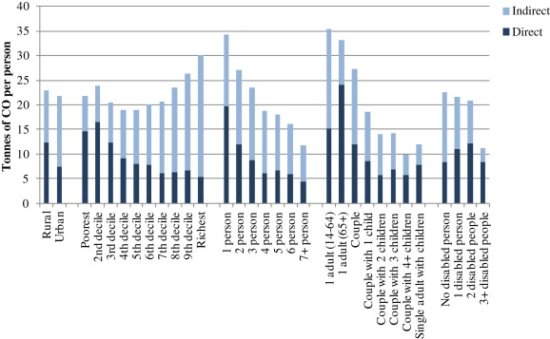
Environmental Justice
Pressure on the environment is different for different socio-economic groups

Slide 34
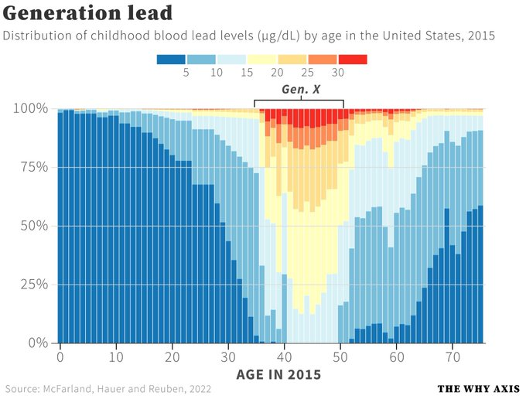

Slide 35
Environmental Justice
Pressure on the environment is different for different socio-economic groups
Concerns about environmental justice do not stop there

Slide 36
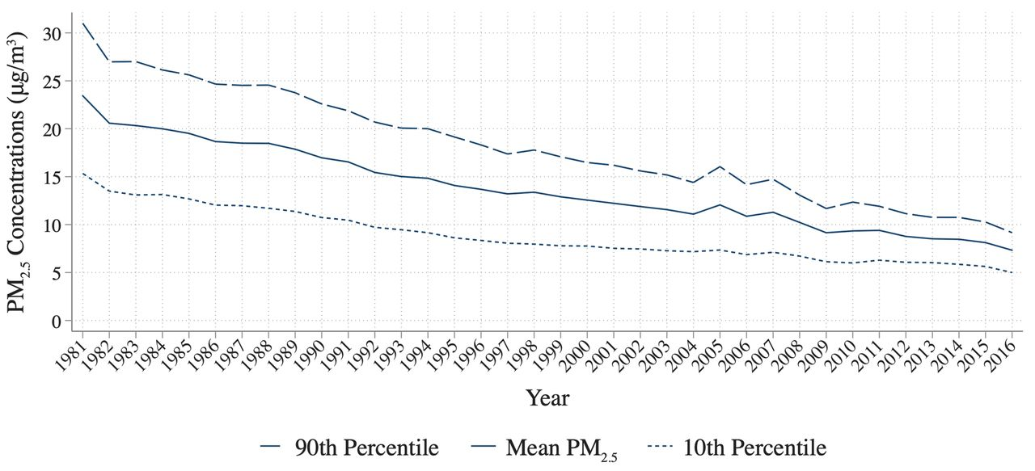
Jonathan Colmer et al. Science 2020;369:575-578

Slide 37
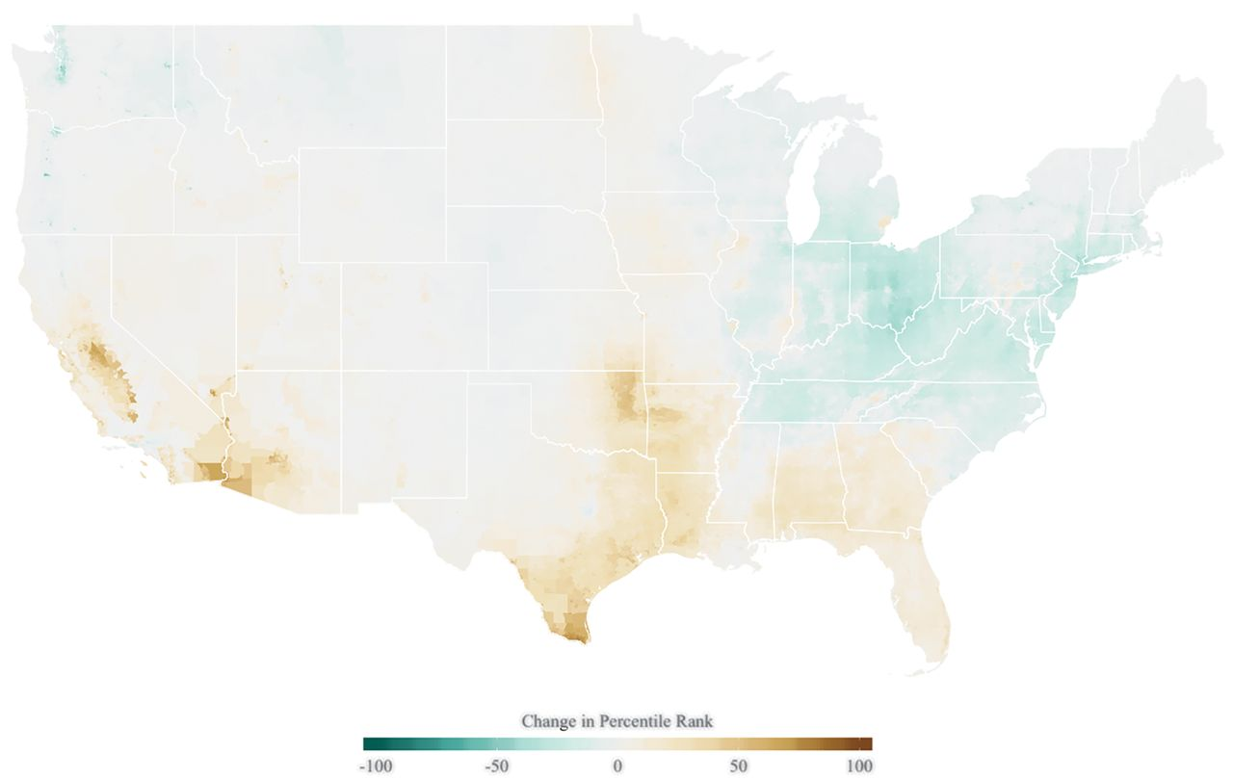
Jonathan Colmer et al. Science 2020;369:575-578

Slide 38
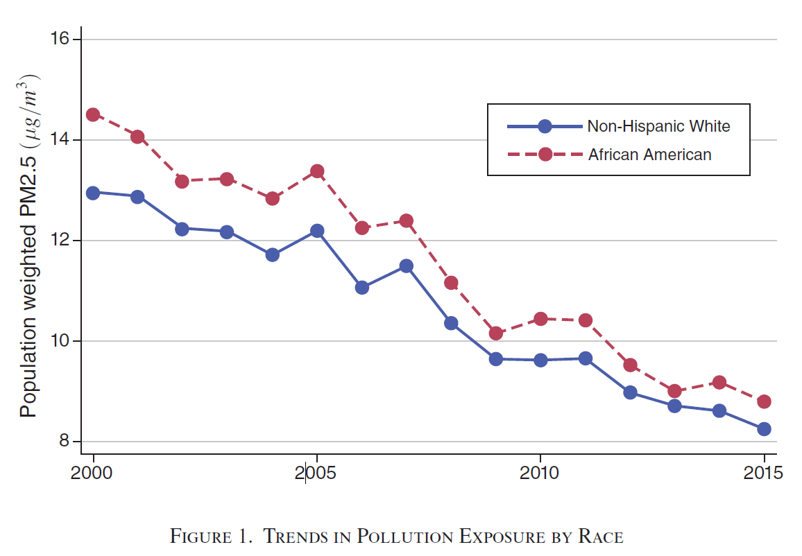

Slide 39
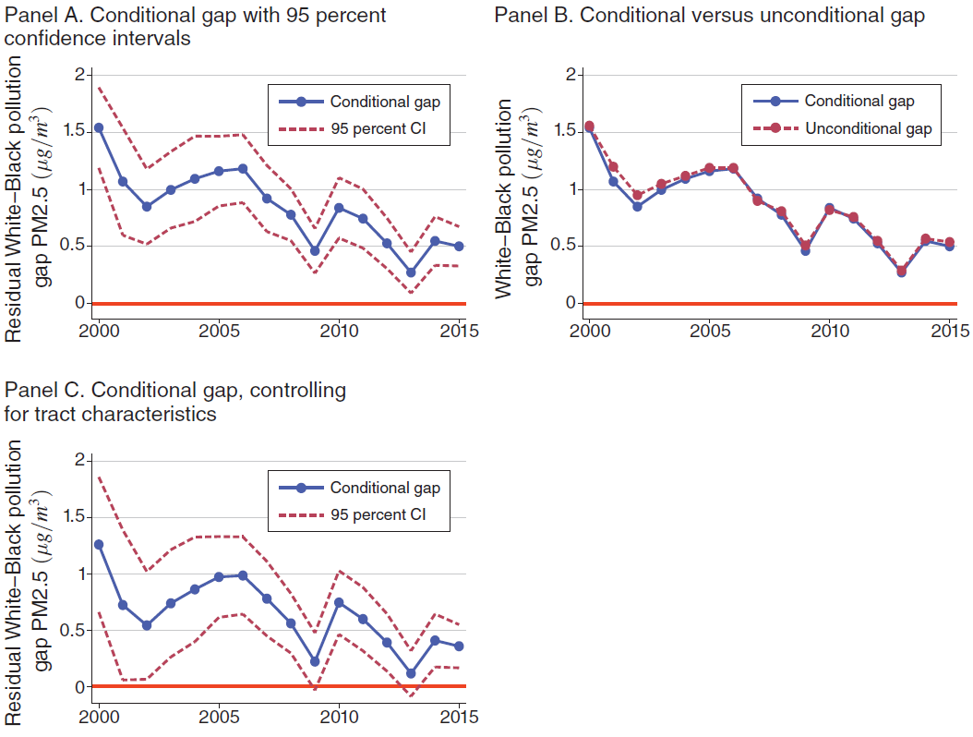

Slide 41
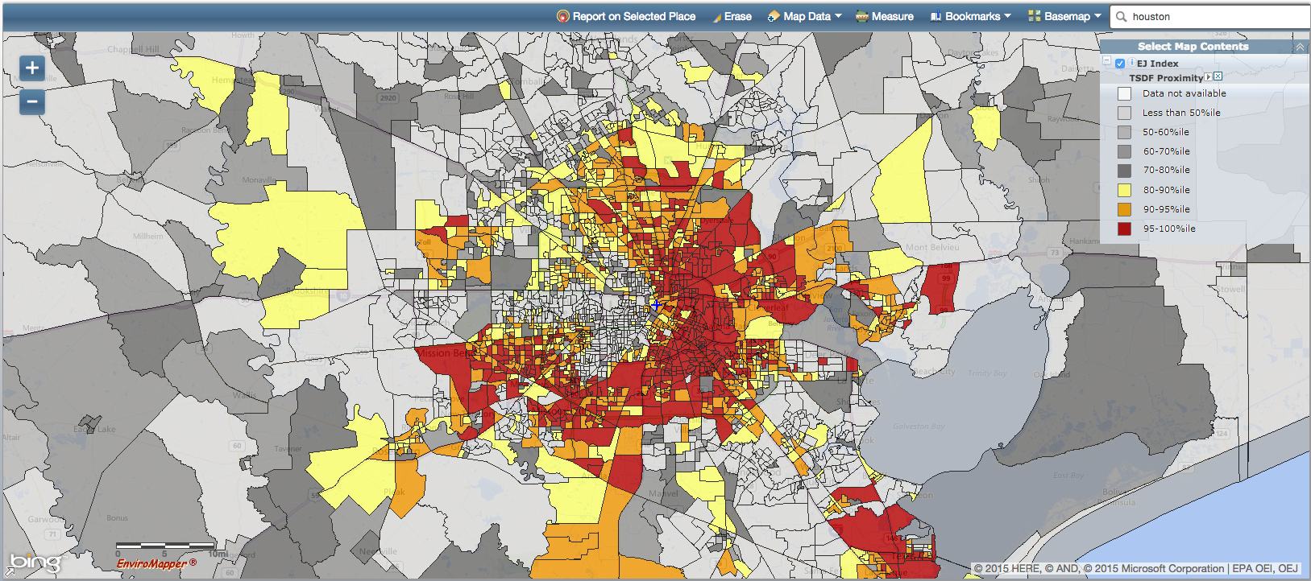
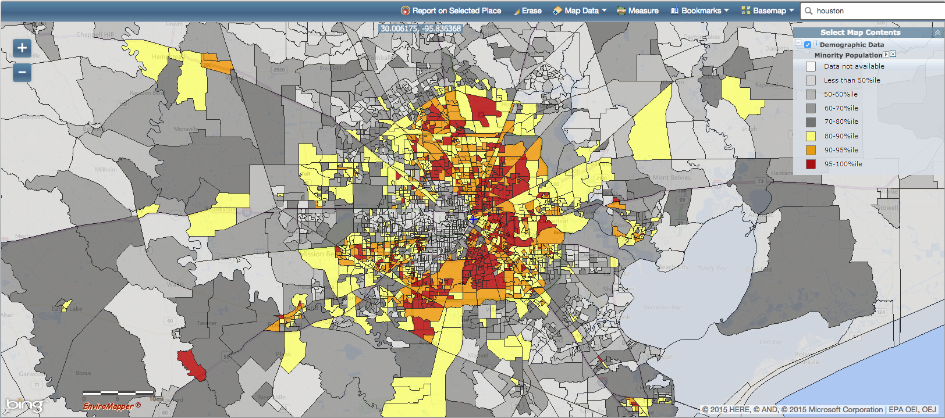
Houston
waste
minorities

Slide 42
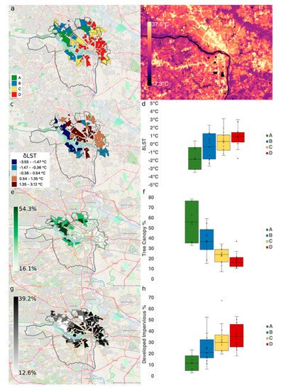
Richmond
1930s redlining
temperature
temperature
by polygon
tree cover
impervious
surface
Hoffmann et al. Climate 2020, 8(1), 12

Slide 43

Environmental Justice
Pressure on the environment is different for different socio-economic groups
Environmental hazards tend to be sited near the poor and deprived
House prices are lower near environmental hazards, attracting the poor and deprived

Slide 44
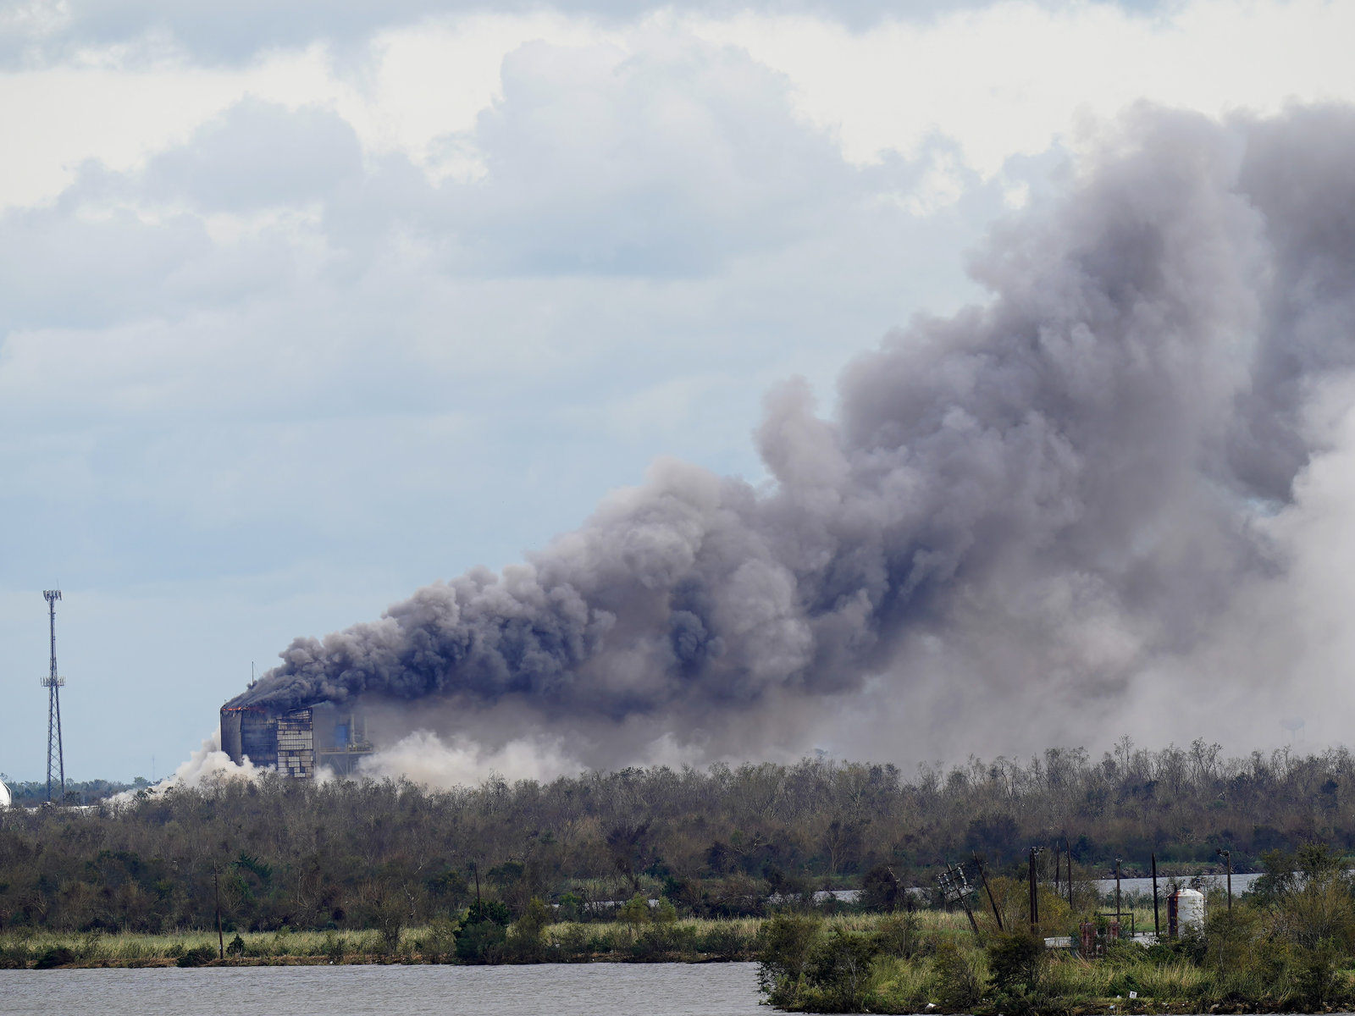
A chemical plant caught fire after Hurricane Laura

Slide 45
“We have sacrifice zones across the Gulf Coast. They are communities of color and lower wealth communities that are often pushed into our most dangerous locations through redlining, through restrictive covenants [and] through zoning practices.”
Mustafa Ali, former EPA

Slide 46
Environmental Justice
Pressure on the environment is different for different socio-economic groups
Incidence of environmental policy is therefore different for different groups

Slide 47
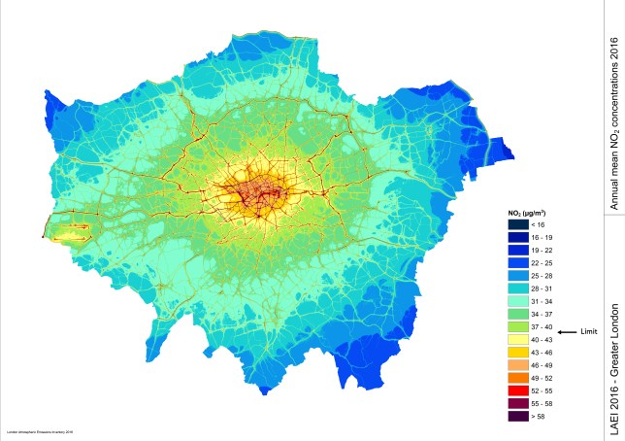

Slide 49

London air pollution
particularly hits the poor,
so congestion charges
primarily benefitted the
poor.

Slide 50
A complicated relationship
Environmental pollution (clean-up) disproportionately harms (helps) the poor
Environmental policy typically makes necessary goods more expensive, which harms the poor
Recall the Romantic roots of environmentalism
Environmentalism has not fully shed its racist roots

Slide 51
Golden Rice
250 million kids suffer vitamin A deficiency
1 in 100 dies
Rest are more prone to infections, blindness
Golden rice is genetically modified to contain the beta-carotene needed to solve the problem
It’s been available since 2004, declared safe for consumption in 2018
It’s still not on the market, mostly because of the resistance of organizations such as Greenpeace

